Slide 1

VE300 Technical Communication
Week 1
Technical Project Design, Problem Definition, and Problem-Need Solution Analysis
Michele Campbell
Summer 2020

Slide 2
Plan for today
Course objectives and policies
Organization of a technical project
Problem definition and evaluation criteria
Problem-need-solution analysis

Slide 3
Opening Question
What problems or issues (social, cultural, economic, technological) has COVID-19 created?

Slide 4
Course Objectives
Strengthen students’ ability to define a technical problem through benchmarking and needs analysis
Develop students’ ability to report technical data in writing and a variety of visuals such as charts, graphs, tables, and diagrams
Improve students’ ability to properly cite and format graphics, equations, paragraphs, and references
Cultivate students’ presentation skills, particularly intonation, body language, and group interaction
Strengthen students’ command of the features and linguistic structures of technical language

Slide 5
Course Format
Workshop style
One-third of time: I lecture on new material
One-third of time: You work on writing exercises
One-third of time: I provide usable feedback and the chance to implement it
Flipped classroom
Out-of-class time is used for reading or watching lecture material
In-class time is spent on practice exercises
Peer review
Intensive case studies (due to lack of capstone project, and also lack of face-to-face interactions because of coronavirus)

Slide 6
Course Policies
Attendance
Participation
Food and drink
Assignments
Electronic devices
Honor code
Security

Slide 7
Your Responsibilities
Attend every class, log in on time
Participate actively during class and on all assignments
Communicate with me about your writing needs (otherwise I won’t know how to help you)

Slide 8
My Responsibilities
Provide you with ample opportunities for writing practice
Give you clear guidelines on how each assignment will be graded
Provide feedback and material that are directly applicable to your needs (but I can only do that if I know what those needs are)

Slide 9
JI Students: Common Areas of Struggle
Differentiating between problems, needs, and solutions
Defining the problem, and making sure the purpose logically follows from it
Converting qualitative customer requirements into quantitative technical specifications
Purpose and structure of a literature review
Writing with appropriate tone: abstracted and de-personalized
Weak evidence and one-sentence paragraphs
PPT slide formatting: content, layout, sponsor logo

Slide 10
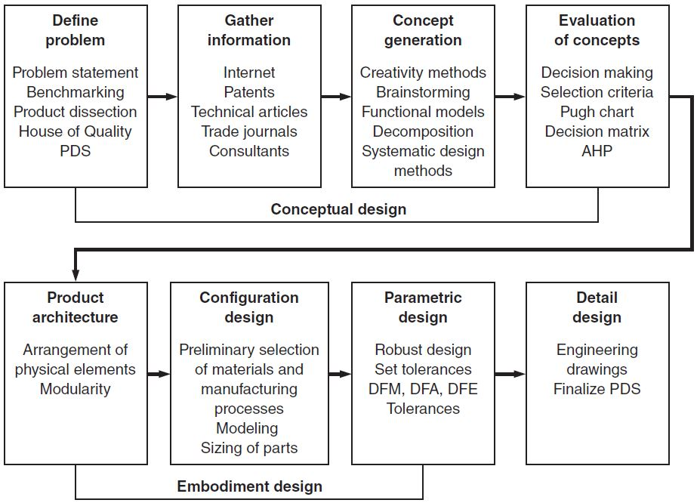
Engineering Design Process
Source: Dieter & Schmidt (2013), p. 15

Slide 11
Technical Project Design
Criteria | The categories by which the problem will be evaluated
Problem | The shortcomings (impact on people) of existing devices, as assessed by the criteria
Need | The things that are required in order to fix the problem – the general “what”
Solution | The way in which those needs will be met – the specific “how”
Remember: Every need and solution must be directly tied to one of the established evaluation criteria

Slide 12
Example: Spring-Loaded Mousetrap
“We are being infested by mice, but we do not have enough electrical power for an electronic solution.”

Slide 13
Example: Spring-Loaded Mousetrap
Criteria
Needs
Number of mice
Power consumption
Eliminate the mice
Must not consume any electrical power
Problems
Solutions
Infestation of mice
Mice carry disease
No electrical power available for any solution
Bait lure, mouse-triggered, passive spring-loaded trap which captures or kills the mice

Slide 14
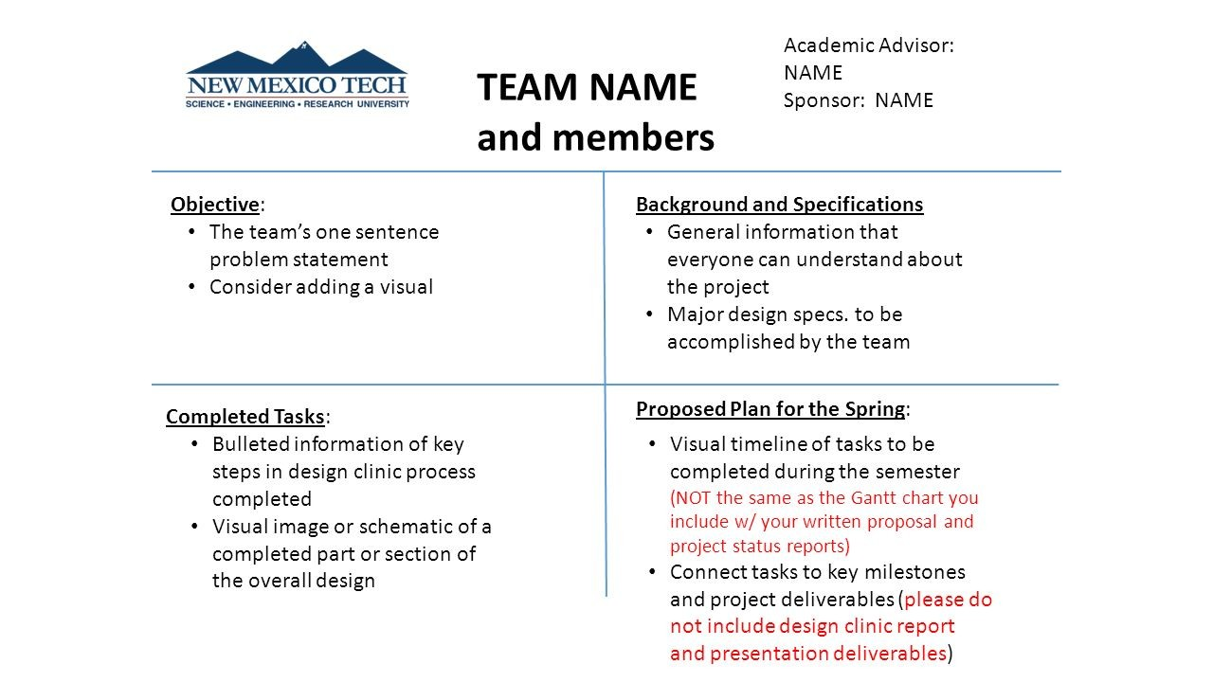
Quad Chart Sample #1
Source: https://slideplayer.com/slide/7728020/

Slide 15
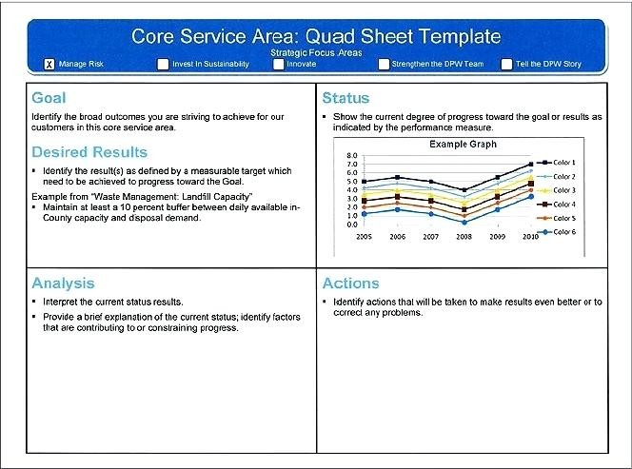
Quad Chart Sample #2

Slide 16
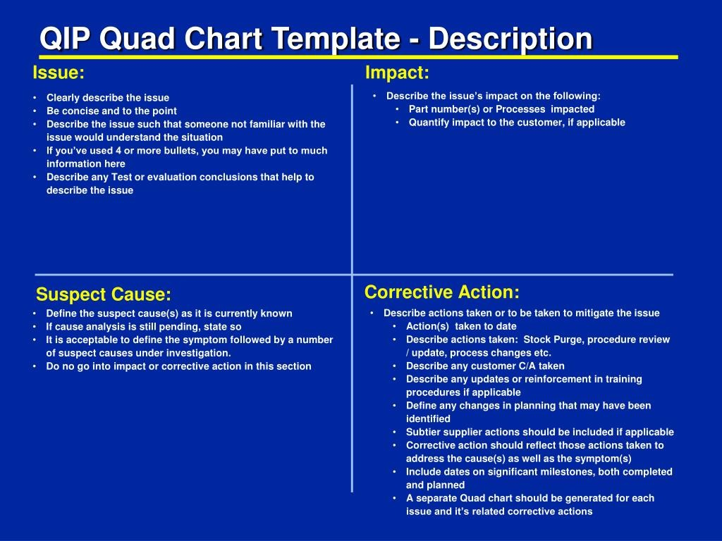
Quad Chart Sample #3
Source: https://www.slideserve.com/mendel/qip-quad-chart-template-description

Slide 17
Your Turn
Download the COVID-19 Challenge (JPEG) and Quad Chart Worksheet files – located in the Week 1 module of the VE300 Canvas page
Using the COVID-19 Challenge as a guide, think of a general problem or issue (technical or non-technical) caused by the Coronavirus (could be social, cultural, economic, technological)
In the quad chart worksheet, establish 2-3 criteria by which the problem will be assessed, and develop 2-3 problem statements based on those criteria
Submit your quad chart through In-Class Assignment located in Week 1 module when I ask you to

Slide 18
Homework
Complete all four sections of the quad chart, 2-3 items each
Write problems, needs, and solutions in complete sentences
Evaluation criteria: 15 points
Content [8]: How logically the criteria, problems, needs, and solutions align
Language [7]: Formal and de-personalized tone
Due on Canvas by the start of next class (assignment submission portal will be opened within the next few days)

Slide 19
Further Practice
Choose a simple, common tool or device that you would like to improve upon
Identify the categories/criteria by which you will evaluate the device
Specify existing problems with the device, according to the criteria
Determine the needs required to improve the device, according to the criteria
Identify potential solutions by which those needs could be met, guided by the criteria

Slide 20

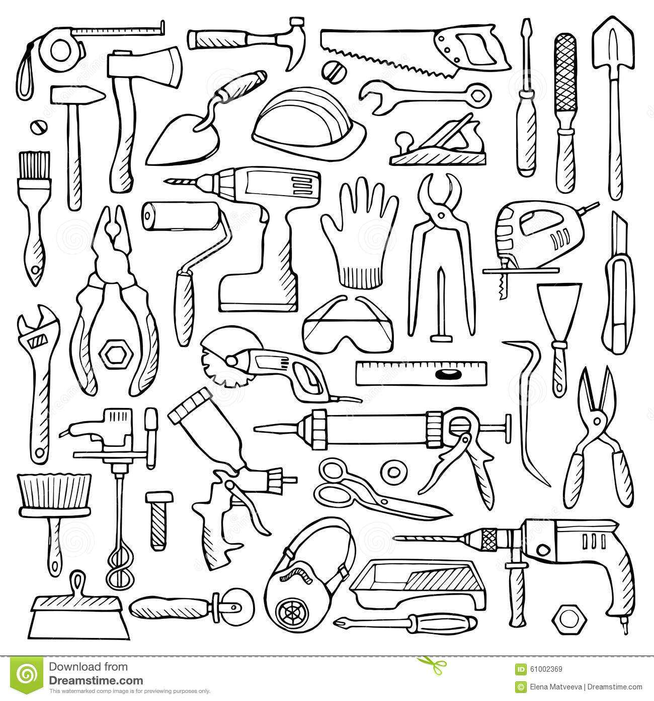
Further Practice

Slide 21
What is academic language?
A register of language appropriate for conveying information in specialized content areas in the social and natural sciences
Register: a variety of language used for a specific topic or within a particular social environment
Social/informal/everyday We guessed right number by…
Academic/formal/technical Type-A uncertainty is estimated by…
Field or subject matter
Appropriate vocabulary optoelectric sensor, uncertainty analysis
Appropriate syntactic structures …valid only under the assumption that…
Relationship between reader and writer
Level of rank or authority: student to professor, professor to funding agency
Level of reader expertise: general public, colleague, project manager

Slide 22
What about academic tone?
Degree of formality Precision can be increased by
Degree of emotion Factors neglected by the model include
Degree of objectivity Valid only under the assumption that

Slide 23
Functions of academic writing
Analyze (分析): show factors involved
Cite (参考): show who said something
Compare (对比) how similar/different
Criticize (批评): highlight weaknesses
Defend (辩护): counter criticisms
Define (定义): give meaning of a term
Describe (描述): features or process
Discuss (讨论): show all viewpoints
Explain (解释): give reasons why
Highlight (强调): draw attention to
Infer (推断): conclude from info
Inform (告知): transmit information
Interpret (诠释): analyze the meaning
Narrate (叙述): tell a series of events
Persuade (说服): convince reader
Summarize (总结): give main points

Slide 24
Features of academic writing
Passive constructions
Nominalizations
Personalization
Lexical density
Abstraction
Specificity
Degree

Slide 25
Coherence and Cohesion
Coherence: content focus, links and transitions between ideas
Cohesion: language focus, links and transitions between words, sentences, paragraphs
 |  | Coherence
 |  | Yes | No
Cohesion | Yes
 | No

Slide 26
Coherence and Cohesion
Narrative: chronologically
Chronological jumps (e.g. flashbacks, backstories) must serve a purpose that fits into the narrative
Descriptive: spatially, categorically
Spatially should have logical progression, i.e. left to right, up to down
Argumentative: categorically
Counter-argument adds credibility to your argument
Expository: categorically
Persuasive: reasons why

Slide 27
Points and Subpoints
Multiple sentences does not necessarily mean separate points
Consolidating multiple sentences that make similar points
Grouping similar points into categories

Slide 28
One Paragraph, One Idea
Every paragraph has one main idea
Content focusing different ideas should be separated out into distinctive paragraphs

Slide 29
Signaling Words and Rhetorical Structure
Time order: at first, eventually, finally
Comparison/contrast: similarly, in the same way, despite, even so
Cause and effect: as a result, because of this, in order to
Generalization: for the most part, on the whole
Attitude: fortunately, unfortunately oddly enough
Summary/conclusion: finally, in brief, in conclusion
Cyclical structure: sharp rise, steep decline, peak, stabilize
Source: http://www.uefap.net/writing/writing-paragraphs/writing-paragraphs-signalling

Slide 30
Peer Review and Process Writing
Students write multiple drafts
Structure focus
Content focus
Grammar and mechanics focus
Students write a paragraph explicitly stating the changes they made to each draft
Students review each other’s writing and make specific recommendations on structure, content, and mechanics
Teacher evaluates drafts, revision paragraphs, and peer reviews

Slide 31
Narrative Paragraph
My trip to China started in Beijing, where I visited the Forbidden City and the Temple of Heaven. Since I didn’t know anyone in Beijing, I found it hard to get immersed in local life beyond the touristy areas, although I enjoyed a lot of shopping at Wangfujing. Then I took the high-speed train to Shanghai. How cool that it only took six hours, where it once would have taken at least a day. The high-speed rail has really made travel more convenient around China now, even though it’s easier to meet people and talk to locals when you’re riding the standard trains. In Shanghai, I visited the Bund and the Oriental Pearl Tower. And it was a cultural experience to see the Marriage Market in People’s Square. Then I took the high-speed rail down to Shenzhen, where some friends took me to Shekou. It really helps to have local friends. You can see a lot more places that you might have otherwise missed. My trip ended across the border in Hong Kong. There, another local friend took me to a traditional dim sum restaurant. We spent two hours there, but the people next to us had been there the whole time and showed no signs of leaving. It seems they go to dim sum not just for the food but for the socializing. Now I understand the social importance of dim sum in southern China. I never would have seen that if I hadn’t had some local friends to show me around. Having local friends makes all the difference when you travel to a foreign country.

Slide 32
Descriptive Paragraph
My friend’s new apartment is divided into a living room, a bedroom, a kitchen, and an outside terrace. The living room has a several plants, a sofa, a bookcase, and several tables including a desk and coffee table. The plants are placed at different corners of the room, while the sofa is centered on the back wall. The bookcase and coffee table did not originally come with the apartment; he had to buy them separately. But he’s still pretty happy with the monthly rent he negotiated. The bedroom has a full-sized bed in the left corner, a nightstand in the right corner, and bookshelves along the right wall. And some ambient, blue lighting which comes out of the ceiling. The kitchen is quite simple but includes a stove and many drawers. It did not come with a dishwasher, but you always have to make some compromises when renting an apartment. He looked at some other apartments that were cheap but really bad, and some that were really nice but too expensive. Finally, the terrace has a washer and closets, which he uses to store his tools and winter clothing. In all, a pretty comfortable apartment.

Slide 33
Expository Paragraph
My family loves to travel. Every summer, my mother and her sister travel around Spain, including Asturias in the north, where their father was born. My parents have also made it a tradition to go to Shanghai every fall, when my father teaches a short course at Shanghai Normal University. Speaking of traditions, our family also gathers in Kiawah Island, South Carolina every year for Christmas. We chose that place because we used to own some properties there. But ever since we sold those properties and the children started getting older, it has become increasingly difficult for us to keep traveling there for Christmas. We don’t want to lose that tradition, because family traditions are important. But maybe we can still find another place to gather for Christmas, to keep our annual gathering tradition alive.

Slide 34
Argumentative Paragraph
Benjamin Franklin reportedly said, “Early to bed and early to rise makes a man healthy, wealthy, and wise.” I think he’s right. Getting up early gives you more time to complete all your tasks. Some people might argue that everyone’s biological clock has a its own set of “peak” hours. But according to traditional Chinese medicine, the liver is one of the most important organs in the body, and its optimal sleeping time is between 11pm and 1am. So, it is important to be in bed by 11pm. Moreover, people who wake up early are often more productive. Going to bed late usually makes you feel tired in the morning. In truth, I often feel the most energetic in the early morning. In essence, it is best to go to bed early and wake up early. You can get more done, and you will feel great!

Slide 35
Persuasive Paragraph
Starting next month, the department will institute a policy where all employees are required to take English classes on Monday and Thursday nights. I understand that this is may not be a popular decision. But there are several reasons why this policy is ultimately beneficial to the company and its employees. First, as we are rapidly expanding our international trading operations, we will be increasingly dealing with foreign clients. Second, company headquarters is considering some budget cuts. If they see that our training budget is not being used, then they will cut it in order to save costs. Third, taking this English class together can build a team spirit, which is important for a good working environment in the department. I hope you will consider these points, and agree that these mandatory English classes after work are actually best for all of us.

Slide 36
Types of Reports
Lab Report | Methods, results, and conclusions of laboratory or experimental work
Routine Report | Routine data to department or shareholders on expenses, personnel, etc.
Progress Report | Tasks already completed, tasks to be completed (with projected timeline)
Completion Report | Outcomes of a project already completed, new initiatives and recommended actions
Regulatory Report | Compliance, how well a department or organization adheres to laws or policies
Incident Report | Details an unforeseen problem or accident, sticks to facts without giving excuses
Brief/Whitepaper | Summary of developments in an industry or sub-field, summarizes lines of research

Slide 37
Parts of a Report
Memo/Transmittal Letter | Current date, greeting to reader, outline of project status
Title | Appropriate keywords for searchability, sufficient detail
Abstract/Executive Summary | Mirrors structure of report, summarizes each section in 1-2 sentences
Introduction | Topic or research territory, problem statement, purpose statement
Methods and Materials | Sampling, collection, analysis, measurements; focus on replicability
Results | Trends, magnitudes, associations, patterns of statistical significance, exceptions
Discussion | Analysis of why results were that way, comparison to prior related projects
Conclusions | Summary of main points and implications in report, next steps, future projects
Acknowledgements | Sources of funding, key people who assisted and/or supervised you
References | Source material you cited in your report, nothing you did not cite in report
Appendices | Long tables of source data, supplementary data not essential to report

